Slide 1
Synthetic data generation using GANs
(Generative Adversarial Neural Networks)
Varun Singh

Slide 2
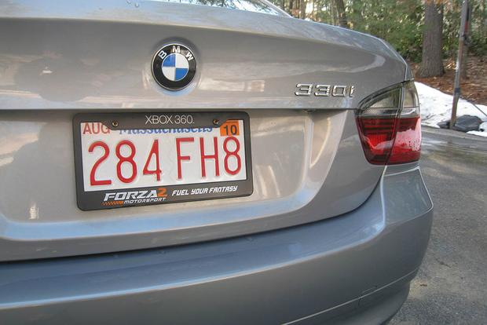
Target Problem
Generate this:
+ “248 FH8”
Or at least this:
+ “MH12 GR 9168”
We want use this data to train ANPR programs.

Slide 3
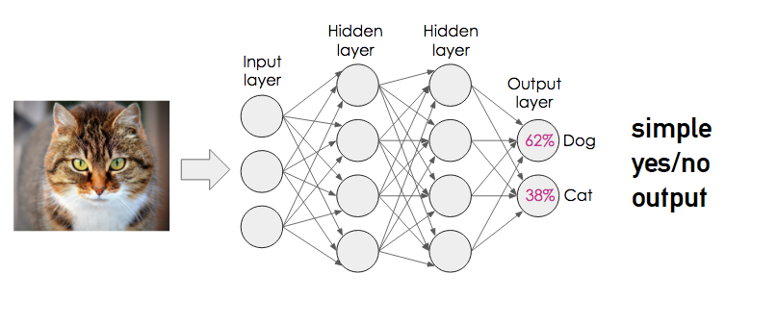
What are GANs? Not this:
(This is just a discriminator. INPUT → CAT/DOG)

Slide 4
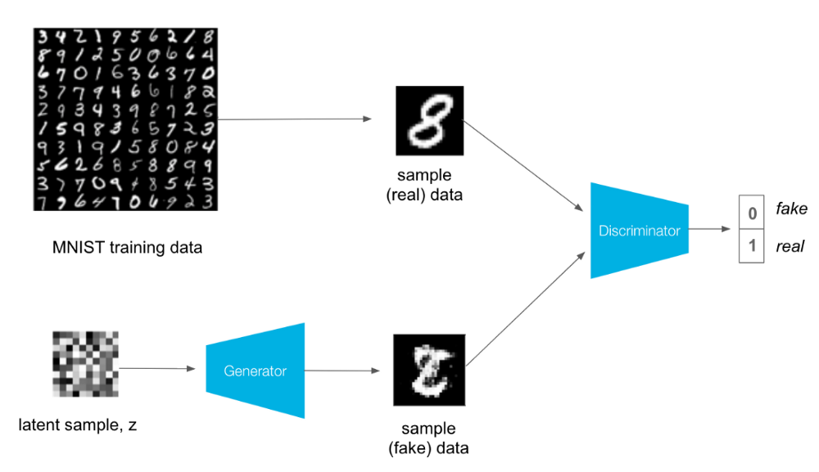
A simple GAN.
Both neural networks evolve in tandem. Discriminator tries to tell real data from fake. Generator must train to produce convincing images to fool the discriminator.

Slide 5
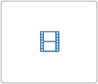
Results of a simple generative network.

Slide 6
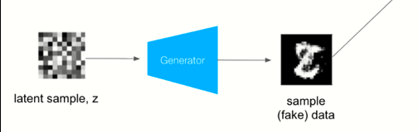
Problems with such a GAN
RANDOM INPUT → ANY NUMBER (G is a blackbox. )
Doesn’t supply labelled data.
Cannot produce annotated license plate images.
Simple number generation took a 60,000 images looped over 200 epochs to train.
I have only 350 photographs for the actual problem.
Clearly brute force generation won’t work.

Slide 7
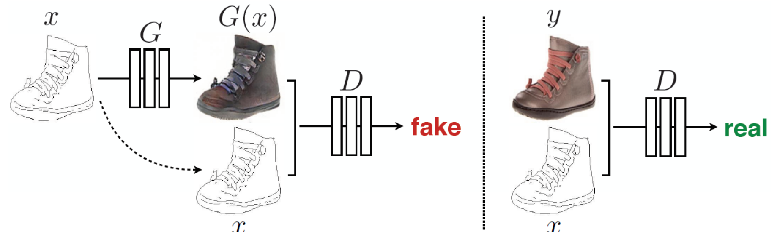
Conditional GANs (Pix2Pix in particular)
We’re working with labelled pairs of data. Doing Image to Image translation. Call it a fancy coloring app.
y = G(x) will have same label as x.

Slide 8
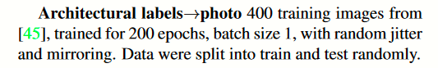
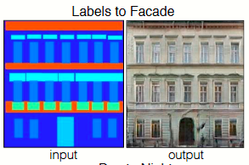
Excerpt from pix2pix paper

Slide 9
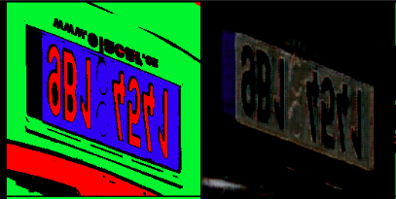
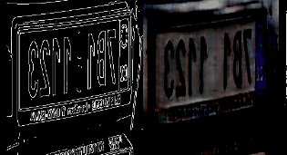
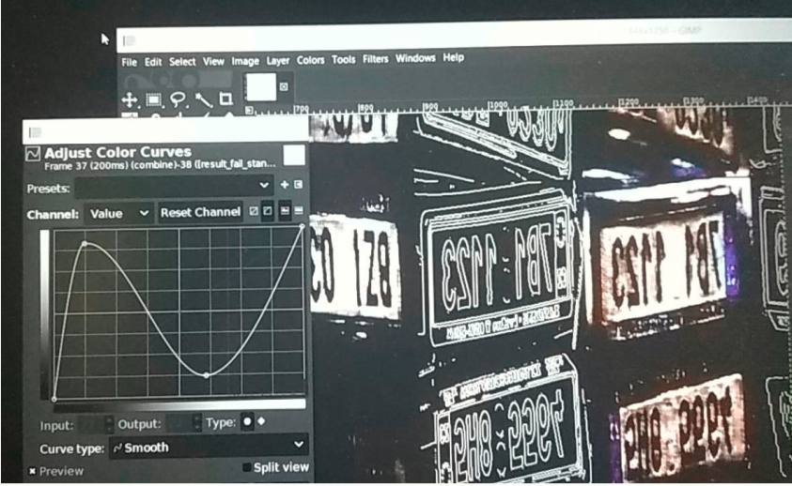
Low data, little training: Poor results
Color → Photograph FAILURE
Outline → Photograph FAILURE
Even if I brightened the generator output there was too much chromatic aberration.
SOLUTION: RGB → HSL → Grayscale

Slide 10
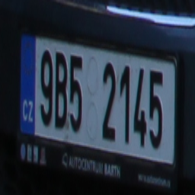
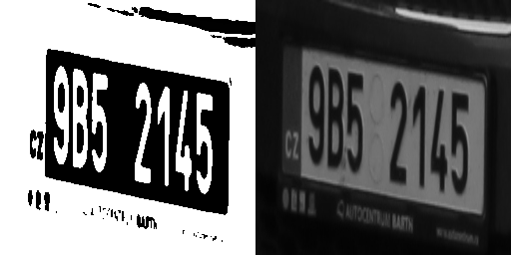
data preprocessing
PHOTOGRAPH
SAMPLE INPUT PAIR
(2_bit → desired_greyscale_output)
Drop the pesky, confusing RGB; change input image space to simple pure BLACK/WHITE and output to grayscale photograph.

Slide 11
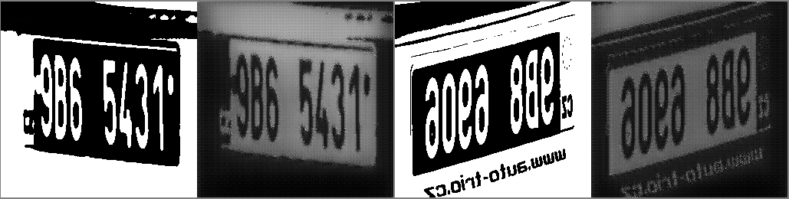
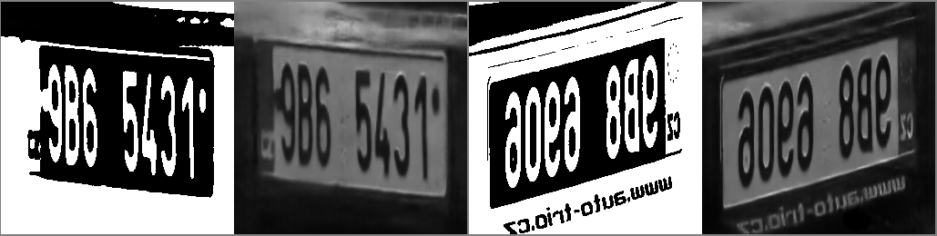
Acceptable results
240 images, 10 epochs
240 images, 200 epochs

Slide 12
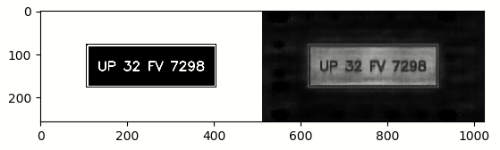
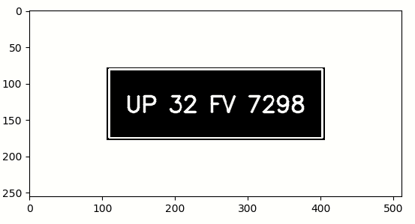
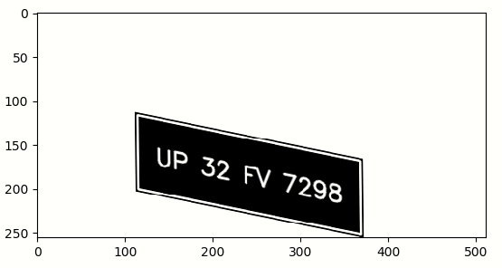
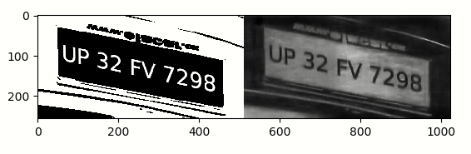
Generating arbitrary numbers
I could just do this, but the GAN has learned a lot more than simple shading.
Did a perspective transform and put number on a image model already trained on for better results.

Slide 13
Limitations of this approach
That perspective transform matrix was calculated manually. Automating didn’t work out.
No font variation
It’s a shading AI.
Preparing templates by hand is unacceptable.

Slide 14
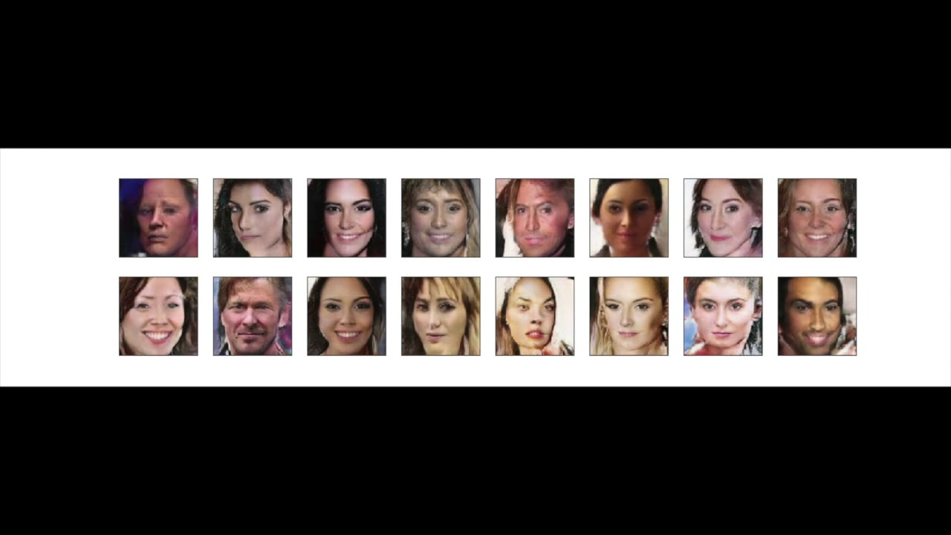
What’s possible?
Models like DCGAN could generate photorealistic plate images from random noise input. It will thus be unlabeled.
Need A LOT of diverse training data – which we don’t have. The raison d'être of my problem statement.

Slide 15
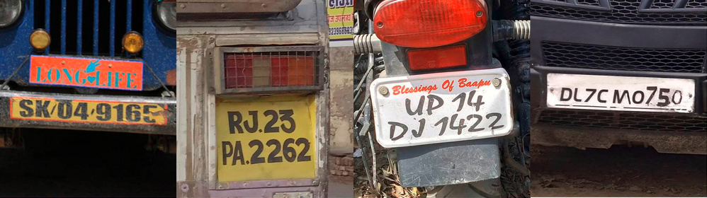
What’s not possible?
If we’re trying to generate lots of synthetic data from a few images, then it is unrealistic to expect a model that can produce a picture from thin air (aka noise).
Any viable solution will take structured, known input and morph it with some randomization.
cannot be done
x 250 images

Slide 16
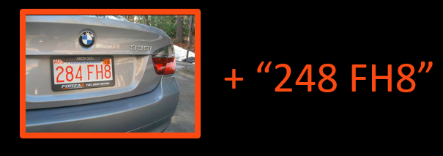
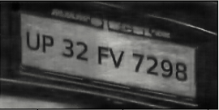
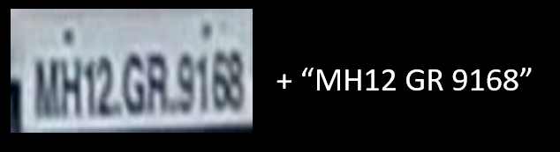
Reduction in scope
CelebA dataset has 2,00,000 annotated images. I don’t have anything like that.
Deemed impossible.
I tried. Okay-ish results. Preparing a set of diverse templates is far too much manual labour. Hard.
Lower resolution. No background. Got enough data to mimic. Easy.
+ “UP 32 FV 7298”

Slide 17
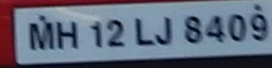
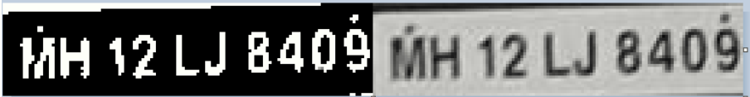
Data preprocessing
Snag: Too low resolution. Down-sampled to practically nothing in pix2pix.
Sample Input Pair (2_bit → desired_greyscale_output)

Slide 18
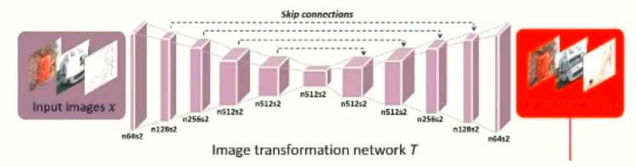

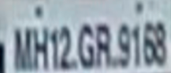
Modifying generator architecture
128x32
image
destructive
down-sampling
1 pixel
nonsense
reconstruction
noise
Solution: Reduce network depth. Use a ‘tiny-pix2pix’.

Slide 19
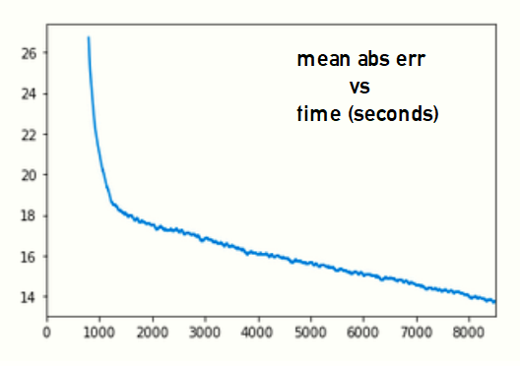
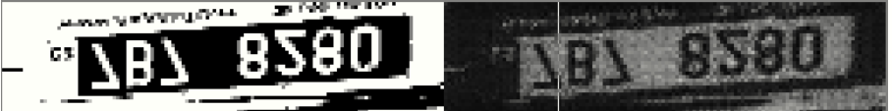
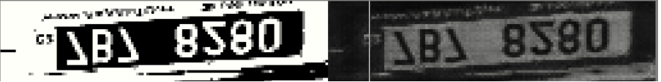
Training
Noise

Slide 20
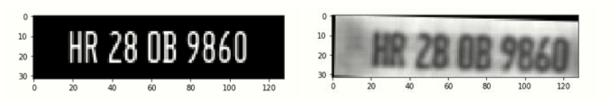
Arbitrary Number Generation
Rules for Indian Vehicle Number Plates from Wikipedia.
Generate random string
Make input image
Shade with GAN
Apply random jitter

Slide 21
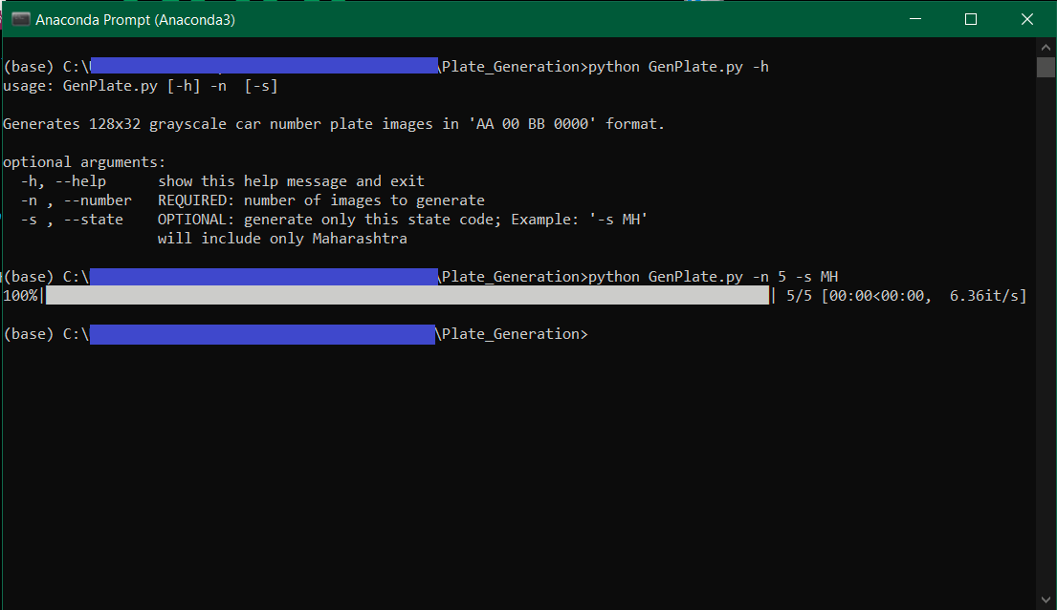
Command line application

Slide 22
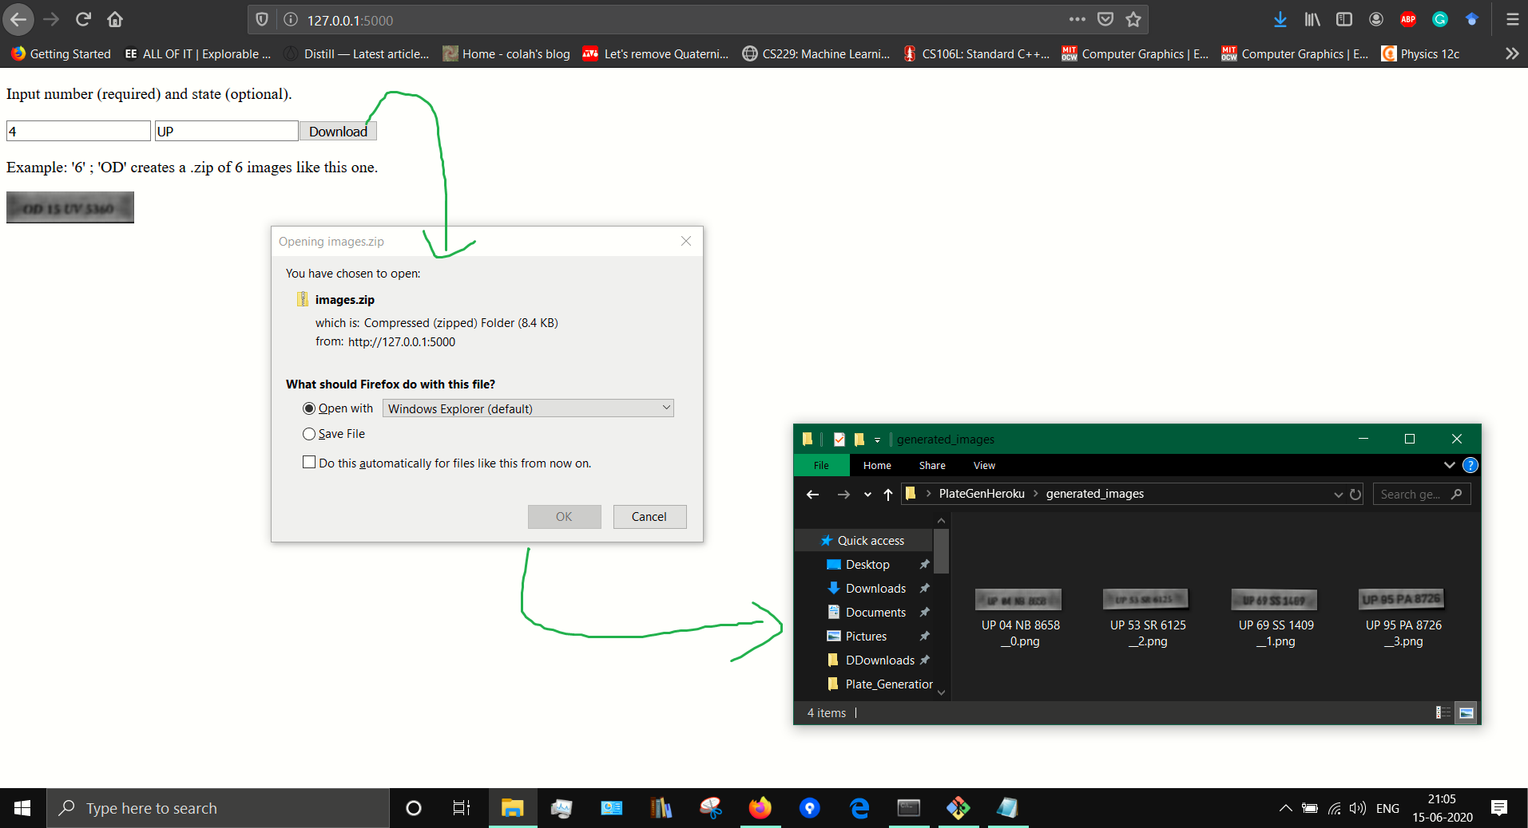
Web front-end

Slide 23
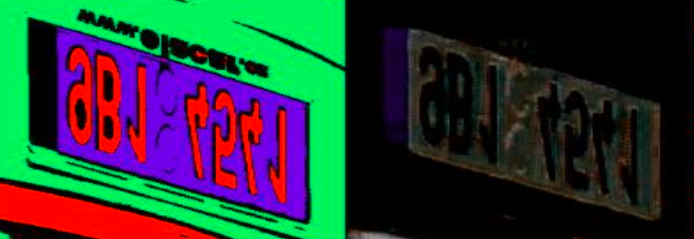
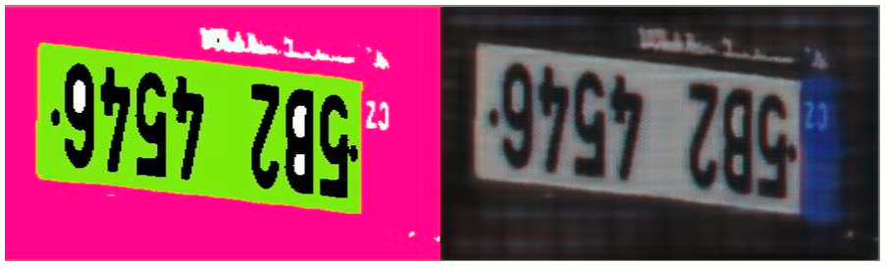
Extra: Correcting a blunder
Forgot to change floats [-1,1] to integers [0, 255] before display and thus abandoned colored shading.
Still unviable (because templates reqd.) but I should’ve caught this earlier.

Slide 24
Questions?

